Slide 1
Spec diff

Slide 2
Naming diff: external debug and smmtt
Mdbgen
Mtrcen
Mseccfg.sdbgen
Mseccfg.strcen
Medbgen
Metrcen
Msdcfg.sdedbgalw
Msdcfg.sdetrcalw

Slide 3
Spec diff : external debug and smmtt
M-mode control
Mdbgen=1
Abstract commands
Relaxedpriv hardwired
PMP, PMA enforced
Mdbgen = 0
Trigger
Cannot enter debug mode in in M-dode
External trigger security rules
Trigger chain security rules
Reset are dropped
hart reset
ndmreset
Resethaltreq
Keepalive is dropped
M-mode control
Mdbgen =1
“no restriction”
Mdbgen=0
Trigger
Cannot enter debug mode in M-mode
Cannot raise exception in M-mode

Slide 4
Spec scope of external debug and smmtt
SubM-mode control
Mdbgen = 0; sdbgen =1
Access privilege configurable via dcsr.prv and dcsr.v
Aamvirtual is ignored
SubM-mode control
Mdbgen = 0; sdbgen =1
Privilege level as if `aamvirtual` = 1 and MPP != M-mode
S/U/VS/VU?
Mdbgen = 0; sdbgen =0
enforce triggers are programmed (by M-mode) with `mcontrol.m` bit clear.

Slide 5
Spec scope of external debug and smmtt
CSR access
Sdtrig and Sdext CSRs are restricted as following slides shows
CSR access
Mdbgen=1 || sdbgen =1
Read and Write of Sdtrig and Sdext CSRs are allowed.

Slide 6
Trigger
CSR accessibility
Register | W/O Zedsec | W/ Zedsec
tselect(0x7a0) | Always | No change
tdata1(0x7a1) | Always | No change
tdata2(0x7a2) | Always | No change
tdata3(0x7a3) | Always | No change
tinfo(0x7a4) | Always | No change
tcontrol(0x7a5) | Always | Debugger Priv. Mode = M
scontext(0x5a8) | Always | Debugger Priv. Mode >= sub-M
hcontext(0x6a8) | Always | Debugger Priv. Mode >= sub-M
mcontext(0x7a8) | Always | Debugger Priv. Mode = M
mscontext(0x7aa) | Always | Debugger Priv. Mode = M

Slide 7
Trigger
Tdata1 fields accessibility
Field | Accessible Debugger privilege
vs | >=Sub-M
vu | >=Sub-M
m | =M
s | >=Sub-M
u | >=Sub-M

Slide 8
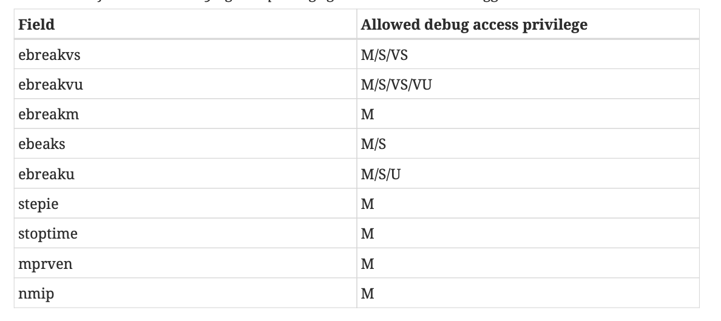
DCSR

Slide 9
Spec diff : external debug and smmtt
System Bus Access
Mandate bus initiator protection e.g. IOPMP
Trace
Trace control knob affects trace module
System Bus Access
Not mentioned
Trace
“External trace refers to tracing software running on a separate target”
“This extension only affects debug or trace orchestrated by an external actor”
Seems contradictory to trace spec

